Slide 1
Becoming a Cyclistic Member
By Anthony Massaquoi

Slide 2
Problem
Cyclistic wants to find ways to increase revenue in their company.

Slide 3
Solution
Help convert casual riders into annual members.

Slide 4
Goal
Use data given by Cyclistic to see how to increase membership rate.

Slide 5
Data Source
The data sources utilized in this assignment have been borrowed from the "Index of Bucket divvy-trip
data. "Data from March 10th, 2021, is used for the analysis to help provide more clarity on the different riders, understanding their cycling demographics and overall well-being.

Slide 6
Summary of Analysis
The initial assessment revealed that the company has more members than casual riders at 80% and 20%, respectively. Over thirty-nine thousand annual members take rides per day from the company, representing 80 % of the daily rides and over ten thousand casual riders take rides annually from the company. Representing 20% of total rides per day.

Slide 7
Summary Statistics
ride length
Mean | 0:24:25
Standard Error | 0:01:01
Median | 0:11:00
Mode | 0:00:02
Standard Deviation | 3:47:32
Sample Variance | 0:35:57
Kurtosis | 12376.70
Skewness | 2356:44:05
Range | 502:09:14
Minimum | 0:00:00
Maximum | 502:09:14
Sum | 841.6043981
Count | 49622.00
Largest (1) | 502:09:14
Smallest (1) | 0:00:00
Confidence Level (95.0%) | 0:02:00
The average riding length per day was 24 minutes and 25 seconds.
Most riders prefer riding on Saturday, which is day 7.
The assessments revealed that the average ride length for annual riders was 27 minutes, while the average riding length for casual riders was 19 minutes. The annual riders ride for significantly longer times than the casual riders, which might be a source of increased revenue and usage from them, as shown below.

Slide 8
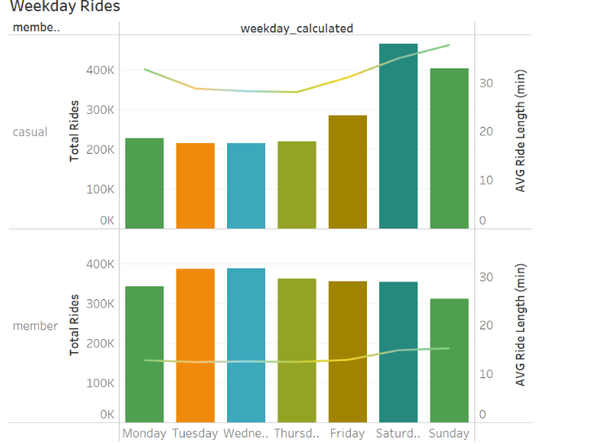
Weekday and Weekend Rides
The annual riders ride for significantly longer times than the casual riders, which might be a source of increased revenue and usage from them.

Slide 9
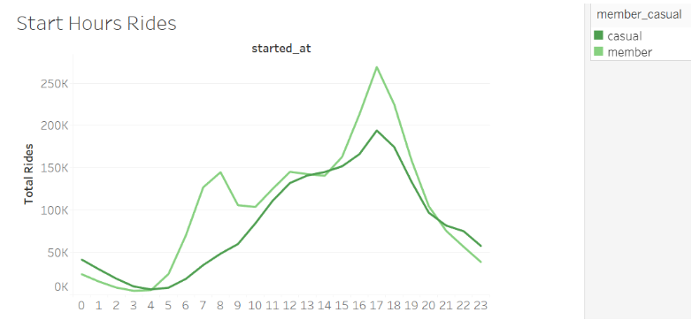
Start Hours Rides
Secondly, annual riders ride more during weekdays compared to casual riders. Furthermore, casual riders have peak hours on Saturdays between 10 and 12 a.m. On the other hand, annual riders have their peak hours at 5-7 p.m. and morning hours between 7 and 9 a.m. The most popular riding station was Michigan, station 13150, and several downtown areas of the State. Most of the bikes used were classic.

Slide 10
Findings
This assessment revealed numerous critical findings from the riders. It revealed that member riders take a longer average time than casual riders. It is also relatively constant during the week and occurs during the morning and evening hours. However, casual riders primarily ride during weekends, and while they have a lower average riding time, they have the most varied riding times, and their rides were predominant during weekends. Most casual riders ride in specific locations while the members ride evenly in distribution around the city.

Slide 11
Recommendations
The marketing campaign should be done during the weekend when there are numerous casual riders in specific regions in downtown Michigan. This is where most of the riders are and thus can be reached by the message. Secondly, the company should focus on coming up with weekly discounts to encourage more casual riders to utilize the bikes during the week and alleviate the skew, and as they start using them during the week, the membership work to come up with specific monthly discounts or the distance covered to influence casual riders to have longer rides and cover more distances influencing them into membership.

Slide 12
Thank you.

